Slide 1
SOLAR POWERED WIRELESS FOREST FIRE DETECTION
SUBMITTED BY
AKSHAYA J
MCA – A
ROLL NO : 07

Slide 2
RELEVANCE OF TOPIC
It is possible to detect forest fires, elevated co2 and temperature levels using internet of things(IOT) sensors. We can deploy IoT, satellite and solar sensors in remote areas without the need for internet, cellular/mobile or mains power.

Slide 3
A DESCRIPTION OF THE PROJECT
This project proposes an effective viable solution for detecting forest fires, in this paper the system incorporates GSM network, so that the signal could be sent any far distance, where the centralized control centre is located. The proposed system consists of smart sensor which uses solar power for its operation and a GSM module which is connected to the GSM network for transmitting the detected fire alarm signal.
When fire is detected, the sensor produces a signal of approximate level which triggers GSM module to transmit the alarm signal to far end control centre. The centre in turn processes the signal and takes necessary action to counteract the situation. Since the sensors in the system powered by the GSM module is powered by solar energy there is no need for conventional electrical energy. It is expected that the system could be a cost effective one and a viable one for detecting fires

Slide 4
The aim of our project is to continuously monitoring forest condition, detection of forest fire and its position and to inform the forest authority. So that necessary action can be taken immediately in case of fire. The two main modules present in the project are the GSM Module and the GPS Module. This gives an importance of wireless sensor technology. The sensors collect the data and transmit to the central unit as well as alert is sent via call or message using GSM.

Slide 5
OBJECTIVES OF THE STUDY
Study the working of Arduino with different sensors.
To understand the operation of GSM module with the Arduino uno for fire detection system.
To study function of different sensors like flame sensor, temperature sensor, smoke sensor.
To review existing techniques applied in the detection of fire at residential level and review their challenges.
To develop a prototype that incorporates multiple sensors to detect residential fire outbreaks.
To test the developed prototype.

Slide 6
EXISTING SYSTEM
Most common systems used in ﬁeld work are video surveillance systems. Video cameras are sensitive to smoke only in day time. Fire sensitive cameras at night, using IR thermal imaging cameras for heat ﬂux detecting and using backscattering of laser light, detect the smoke particles. This ﬁre alert system has a few limitations because of environmental conditions like dust particles, mist, shadows and so on.
Another method is automated picture capturing of ﬁres in forest. Capturing can be done by the cameras which are placed on top of towers. A motor was introduced to give a coverage view on the forest and for its movement (Basu et al., 2018).Captured pictures are processed using program or MATLAB simulation and matching with references taken at beginning stage. This alert system has limitation of false caution rate and visual cameras installed on towers are of high cost.

Slide 7
PROPOSED SYSTEM
In this project, an automatic early warning system integrating multiple sensors to remotely monitor areas of forest for the risk of fire and extreme weather conditions is developed. The system integrates various sensors including temperature sensor, smoke sensor, temp & hum sensor, flame sensor. The signals and measurements collected from these sensors are transmitted to the control centre using GSM module to automatically analyse and combine sensor information and detect the presence of fire or smoke.

Slide 8
BLOCK DIAGRAM
DHT11
MQ2
TEMP & HUM SENSOR
SMOKE SENSOR
ESP 32 / nano
BUZZER
GSM
SIM 800L
Li –ion BATTERY
SOLAR
6V/100 mAh

Slide 9
MODULES
SENSING
ROUTING
COMMUNICATION

Slide 10
COMPONENTS USED ARE:
1. Smoke Sensor 2. Temperature Sensor 3. Arduino nano 4. GSM Module 5. Charging kit 12 v 6. Solar panel 12v 7. LCD Display 8. 12v Li-Ion battery

Slide 11
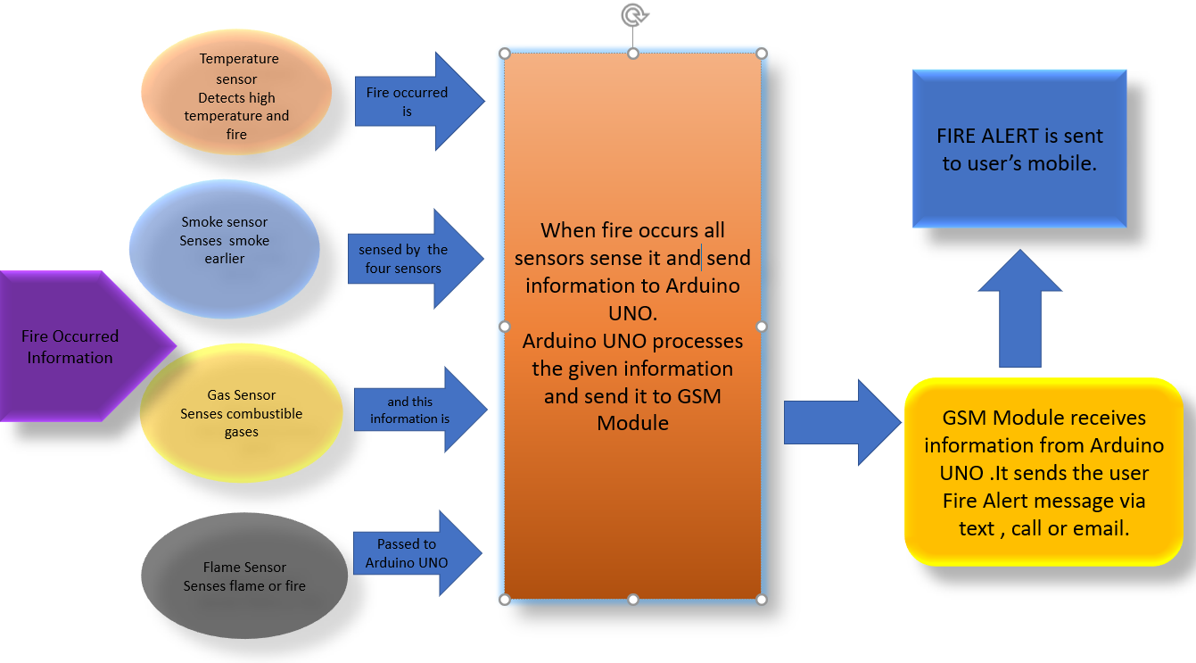

Slide 12
THANK YOU

